Slide 1
Queue implementation using Array
Lecture #
By: Abdul Aleem

Slide 2






Contents
1
Inserting Elements to the Queue
2
Deleting Elements from the Queue
3
Queue Traversal
4
Limitations Of Array Implementation of Queue
5
Practice Questions
6
References

Slide 3


Inserting Elements to the Queue
On inserting the first element to an empty queue with FRONT = -1, REAR = -1 the FRONT and REAR are set to FRONT = 0, REAR = 0.
On subsequent insertions, only the REAR is updated as REAR = REAR + 1.
(b) Insert A:
(b) Insert B:

Slide 4

Inserting Elements to the Queue(contd.)
(c) Insert C,D and E:
At this point if we want to insert F then it create a situation called Queue Overflow. So before inserting any element, the “Queue Overflow” condition must be checked.

Slide 5
Queue Insertion
Pseudo-code for Queue Insertion:
Step 1: If REAR == MAX - 1 then, Print ”Queue Overflow” and Return Step 2: If FRONT == -1 and REAR == -1 then,
FRONT = 0, REAR = 0.
[End of if] Otherwise
REAR = REAR + 1.
[End of if]
Step 3: QUEUE[REAR] = item Step 4: Exit

Slide 6
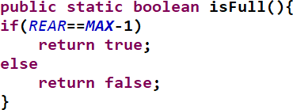
isFull () Method
Queue isFull Method

Slide 7
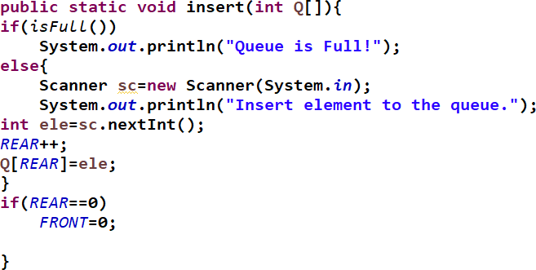
Queue Insertion
Queue Insertion Java Method

Slide 8



Deleting Elements from the Queue
Delete 1 item:
After deleting an item, the FRONT value is increased as FRONT = FRONT + 1.
Delete 3 items:
The FRONT and the REAR refer to the same index when only one item is present in the queue.
Delete 1 more item:
For an empty queue the FRONT and the REAR will be set to -1. Now, if we try to delete more elements from the queue, Queue Underflow situation will arise.

Slide 9
Queue Deletion
Pseudo-code for Queue Deletion:
Step 1: If FRONT == -1 then, Print ”Queue Underflow” and Return [End of if]
Step 2: item = QUEUE[FRONT] Step 3: If FRONT == REAR then,
FRONT = -1, REAR = -1.
Otherwise
FRONT = FRONT + 1.
[End of if]
Step 4: Exit

Slide 10
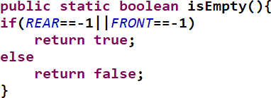
isEmpty () Method
Queue isEmpty Method

Slide 11
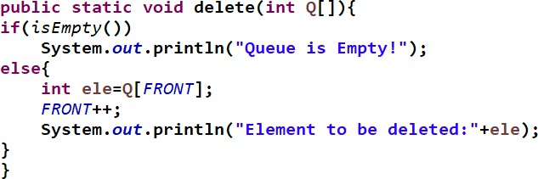
Queue Deletion
Queue Deletion Method

Slide 12

Queue Traversal
Traverse Operation in Queue using Array:
The traverse operation visits each element in the queue starting from FRONT to REAR. It is similar to displaying array elements starting from FRONT to REAR.
Pseudo-code for traverse operation in queue using array:
Step 1: for i = FRONT to REAR
- Print Queue[i]
Step 2: Exit

Slide 13
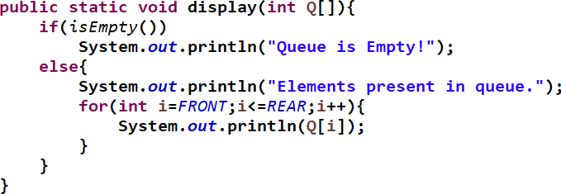
Queue Traversal
Queue Traversal Method

Slide 14
Limitations Of Array Implementation of Queue:
Limitations Of Array Implementation of Queue:
As the Array size is limited we can insert only defined number elements in the array i.e the maximum size of the array.

Slide 15
Practice Questions
In array implementation of queue, what is the condition for checking whether the queue is empty or not?
If FRONT = 11 and REAR = 111, then how many elements are present in queue?
If FRONT = 20 and REAR = 20 , after deleting an element what are the FRONT and REAR values?
If queue size is 100 and FRONT = 99, after deleting one element what are the FRONT and REAR values?
With FRONT = 2 and REAR = 4 insert A, B, C respectively , and delete 2 elements and insert D. What are the values of FRONT and REAR ?
1
2
3
4
5

Slide 16
References
Michael T. Goodrich, Roberto Tamassia, Michael H. Goldwasser ‘Data Structures and Algorithms in Java’, Wiley, 2014.

